Slide 1
Theodicy
The Justification of God
in the face of evil.

Slide 2
The Freewill Theodicy
Human freedom necessarily entails the possibility of evil.
Human freedom requires a real ability to choose otherwise.
Human beings, by virtue of being made in God’s image, are capable of making real moral choices.
We are not determined machines, but free, moral beings whose choices matter.

Slide 3
Compatibilism
But is such human moral freedom truly compatible with divine determinism?
Compatibilism says “yes.”
“A person is free with respect to an action if no causal laws and/or antecedents determine it.”
We are free in so far as we act in accord with our character and our desires.
We are responsible for ourselves.

Slide 4
Even we can predict ahead of time…
If we know beforehand that an upright judge will not take a bribe, or that a parent will rescue their child in distress, or that a miser will clutch their hoard of gold, does our prior knowledge of their character…and thus of their choices…in any way alter the nature of or prejudice the freedom of their moral acts in any of these cases?

Slide 5
Character determines destiny!
Actions are determined by the character of our desires and affections.
Do we not hold the criminal culpable for their crimes, and more so if they are intentional?
Crimes do not spring out of nowhere, but have motive and method
When people freely determine to do wrong, we hold them responsible.

Slide 6
We are morally responsible beings…
The nature of a person determines their behavior.
The responsibility for one’s nature rests with the person themselves.
“The fault, dear Brutus, is not in our stars, but in ourselves, that we are underlings.” (Julius Caesar, 1:2)

Slide 7
Molinism
A theory of divine “middle knowledge” first advanced by the Jesuit theologian Luis de Molina.
God knows all possible hypothetical choices and contingent futures, i.e., all counterfactuals
God’s knowledge of the future is only a hypothetical, ad hoc knowledge.
God adjusts to our ever changing scenarios.

Slide 8
Divine Determinism…
The nature of God’s knowledge of the future and its relationship to our moral freedom is an enigmatic antinomy.
If both are true, then the contradiction is only apparent.
If both are not true, then which one would you like to deny, human freedom or divine sovereignty?

Slide 9
The Cognitive Limitation Theodicy…
Our “thimble full of wit” does not entitle us to judge the ways of God.
Either one trusts God in spite of the evidence like Job or one curses God and dies like Job’s wife.
“The Lord giveth, the Lord taketh away, blessed be the name of the Lord.”
Job says this knowing all the while that the Sabeans stole his livestock and a series of calamities killed his family members.

Slide 10
Vertical vs Horizontal
Job has been given proximate causal explanations for all that has befallen him.
Yet he turns to the ultimate causal explanation instead.
He turns away from mere horizontal explanations to a vertical explanation.
And he sees no contradiction between these two (2) perspectives on causality.

Slide 11
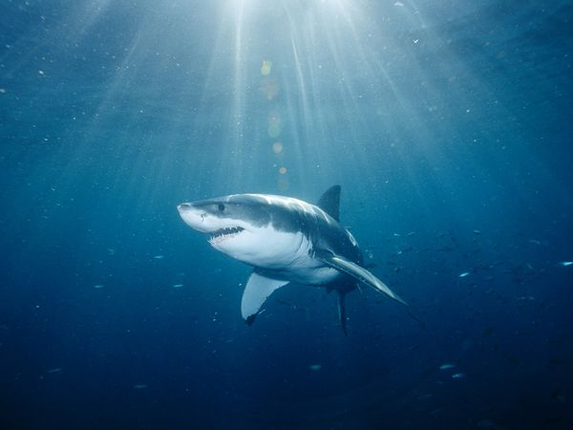
The Apologetic Value of Sharks

Slide 12
“Think outside the box, Job”
The world is full of wild creatures that seem to serve no meaningful purpose.
Job has no more right to an explanation for his suffering than he does to an explanation for why the oceans are stocked with man-eating sharks.
Or snakes, or crocodiles, or lions, tigers and bears!

Slide 13
A Theodicy of Wild Creatures
Wild creatures were God’s way of disabusing Job of his simplistic “tit for tat” notions of God’s justice and providence.
We need to trust God to run history to the ground and establish justice in the earth according to God’s scales, not ours.
Trusting in the Lord is the beginning of wisdom.

Slide 14
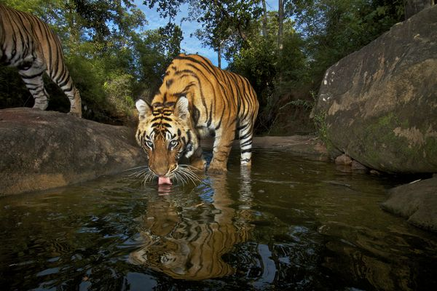
Why does the world need tigers?

Slide 15
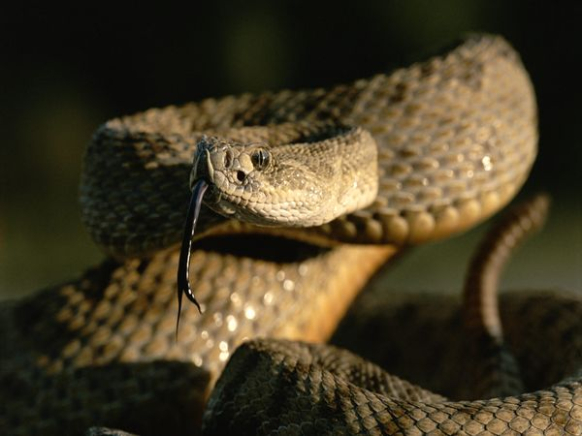
I could live without these too…

Slide 16
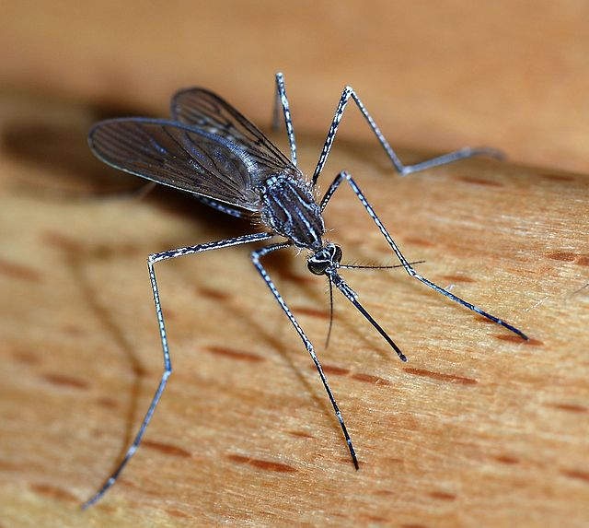
And do we really need these?

